Slide 1

AIRBNB PRICES IN EUROPEAN CITIES

Slide 2
BUSINESS QUESTION
How does the average price of Airbnb listings vary across different European cities and countries?
What main factors influence the price of Airbnb listings in European cities from the data given?

Slide 3
THE DATA
Data was sourced from Kaggle (https://www.kaggle.com/datasets/thedevastator/airbnb-prices-in-european-cities/data)
The data included 10 different European cities with prices from weekdays and weekends.
Data evaluated different attributes from room type, cleanliness rating, guest satisfaction score, number of bedrooms, and distance from the city centre.
Data was analysed using SQL and presented using PowerBI.

Slide 4
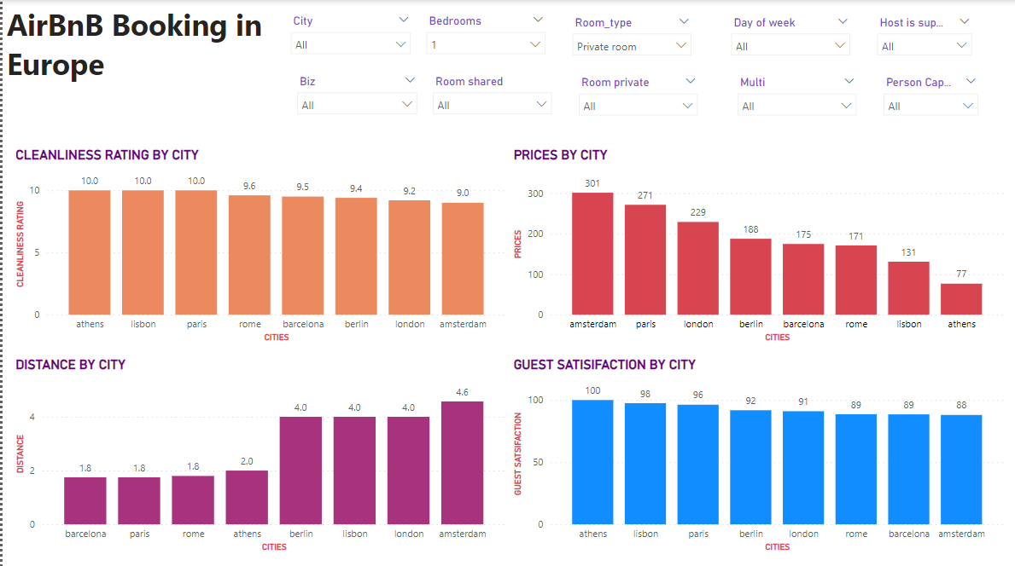
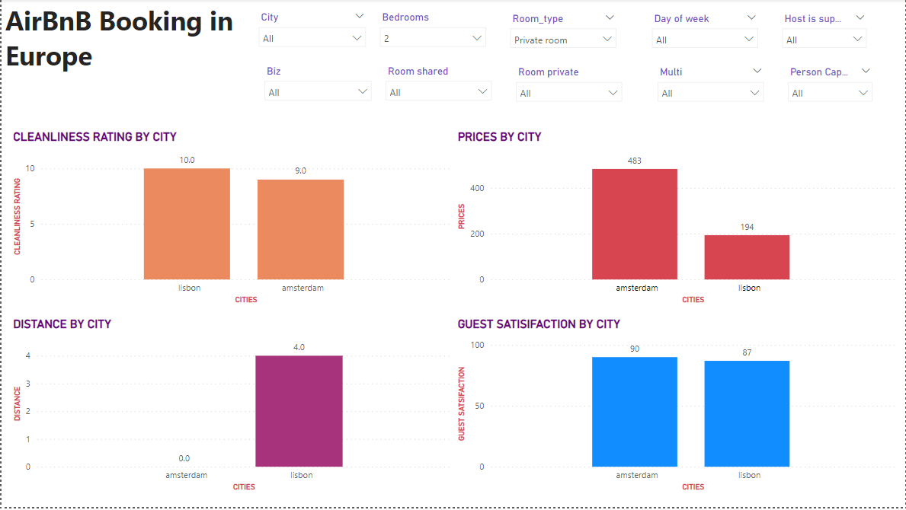
VISUALISATION BY BEDROOMS
In the 1 bedrooms; we can see that the cleanliness, distance and guest satisfaction does not affect the prices of the different cities. For example with Athens; it has the highest guest satisfaction and cleanliness but if you look at the prices – Athens has the cheapest price.
With the 2 bedrooms; Not all cities have airbnbs with 2 bedrooms thus being inconclusive.

Slide 5
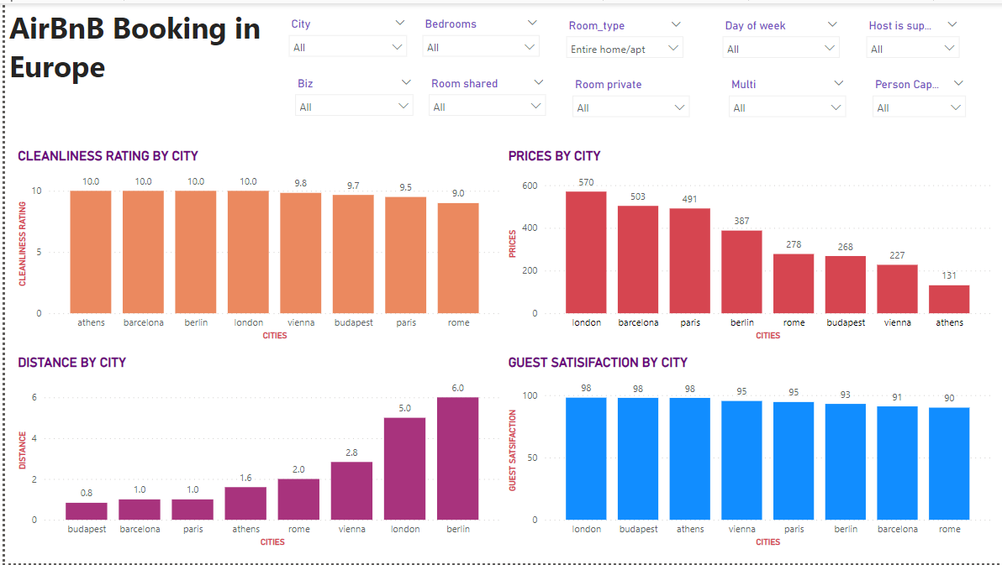
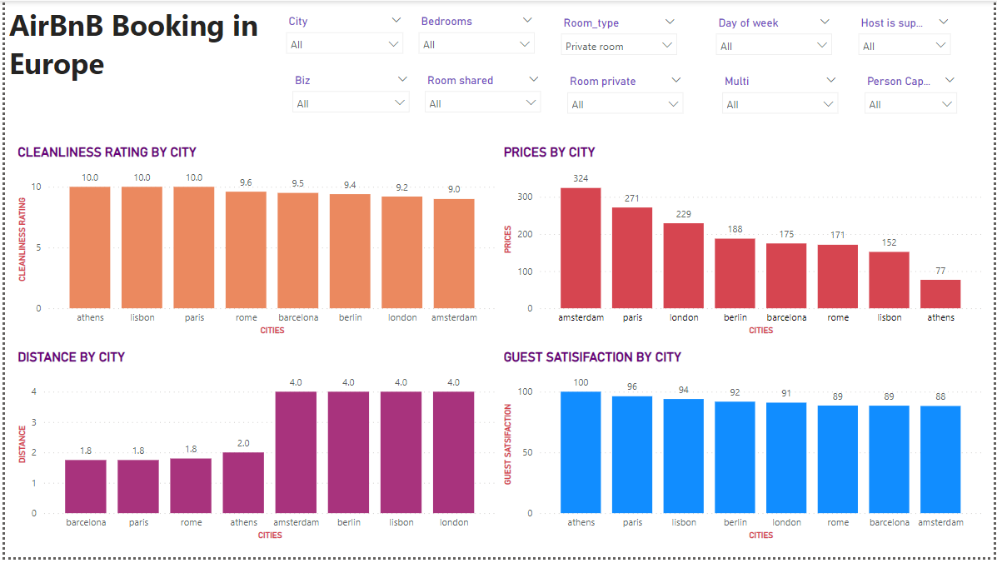
VISUALISATION BY ROOM TYPE
According to the room type; in the circumstances where the entire home/apartment was booked the prices in the cities were higher compared to where the private rooms were booked as they were lower.
The distance, guest satisfaction and cleanliness does not affect the prices of the city.

Slide 6
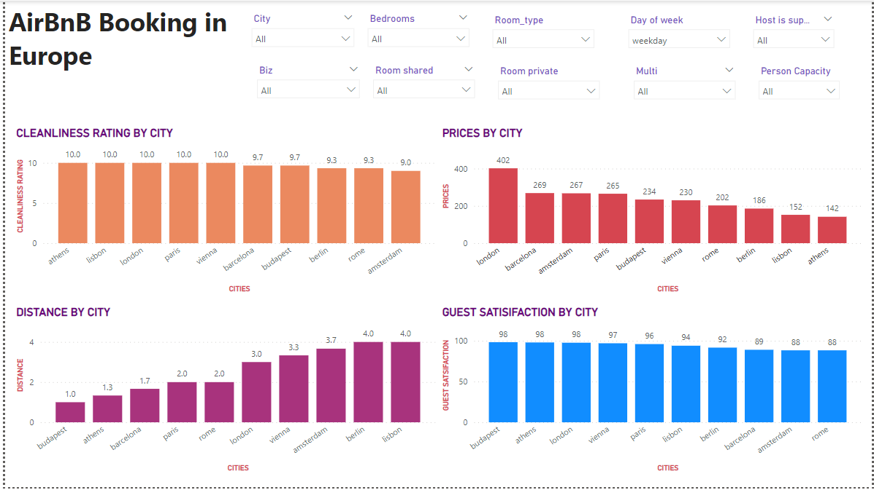
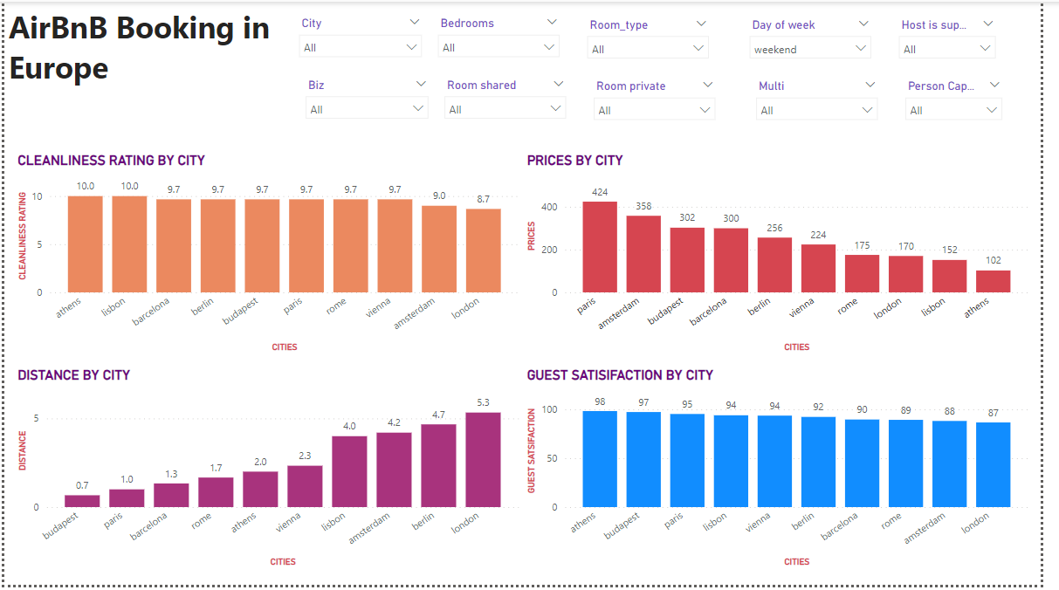
VISUALISATION BY DAY OF THE WEEK
The prices of the cities on the weekday were higher than the prices of the cities on the weekend. Also none of the other factors e.g. distance contributed to that.

Slide 7
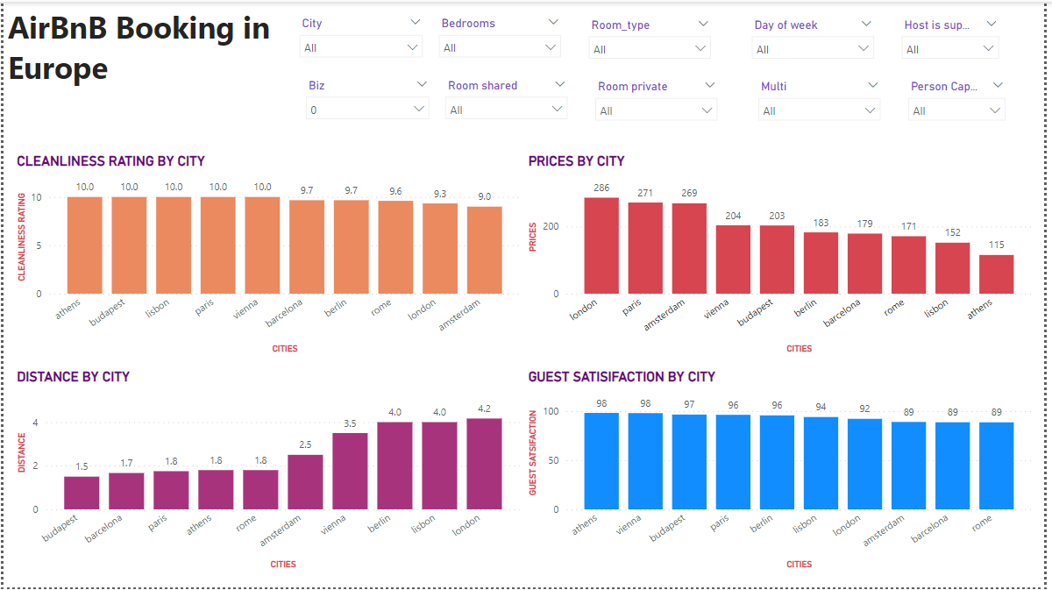
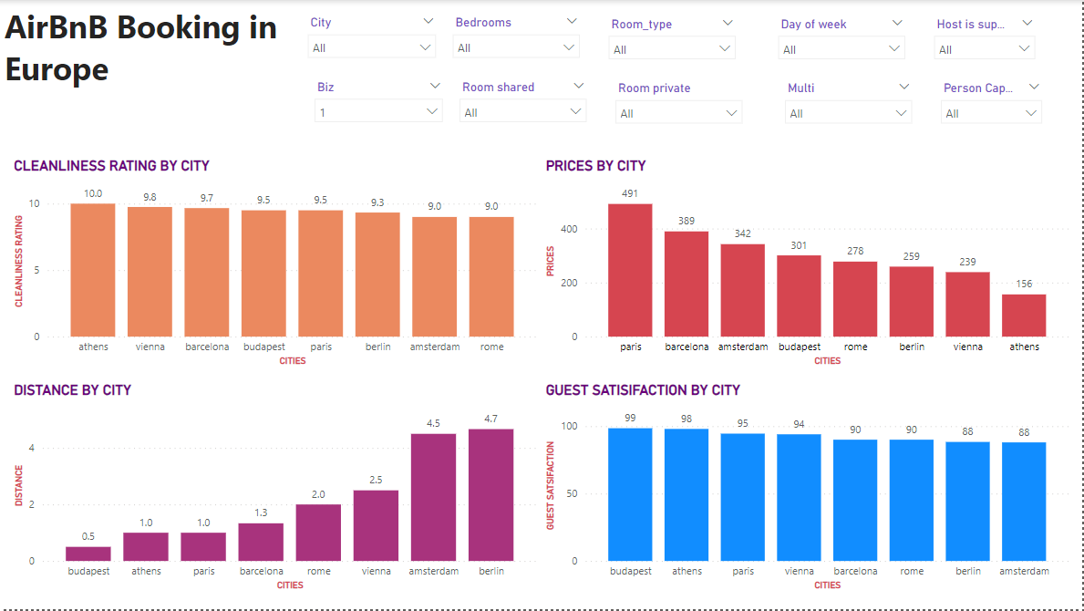
VISUALIZATION BY BUSINESS INDICATOR
Business indicator affects the pricing but the cleanliness rating, distance and guest satisfaction do not have an impact on the prices based on the business indicator.

Slide 8
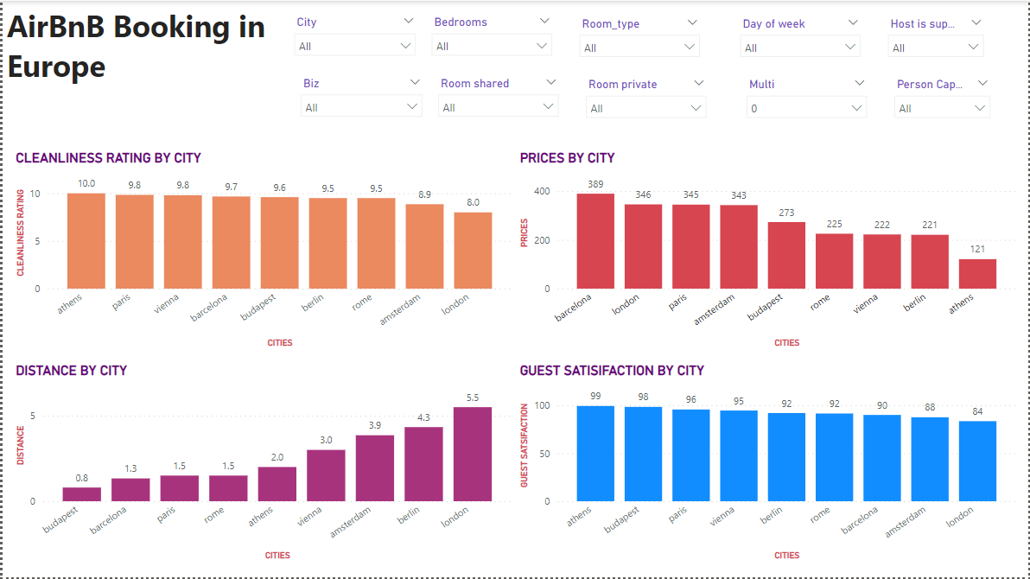
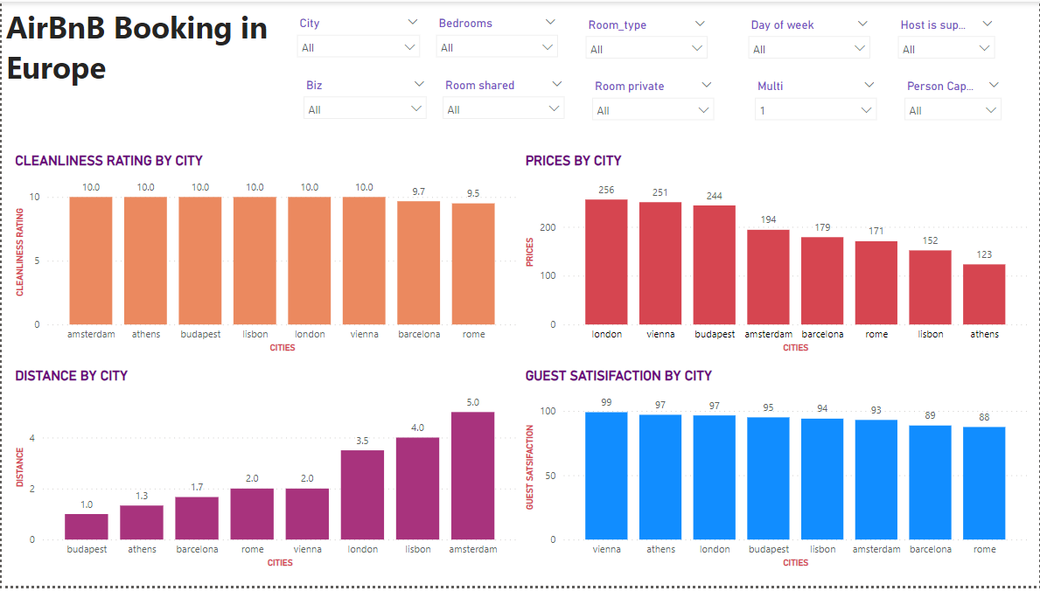
VISUALISATION BY MULTIPLE ROOMS OR NOT
The number of rooms in a business affects the pricing. The prices are higher for properties with single rooms than those with multiple rooms. However, the distance, cleanliness rating and guest satisfaction still doesn’t affect the pricing based on multiple rooms.

Slide 9
CONCLUSION
Based on the analysis that we’ve conducted, it is safe to say that the number of bedrooms, room type, and day of the weeks affect the pricing of AirBnBs in different cities. On the other hand, distance from the city, cleanliness ratings and guest satisfaction don’t have an impact on pricing and therefore the pricing is independent on these factors.

Slide 10
GAPS AND OPPORTUNITIES
Datasets that contain additional information about the cities such as GDP, population, tourism, and crime can be presented. These can help the Airbnb market identify potential areas for growth.

